Slide 1
SQL introduction
SQL- Structured Query Language
Common Language For Variety of Databases
The ANSI (American National Standards Institute) standard language for the definition and manipulation of relational database.
Some common relational database management systems that use SQL are: Oracle, Sybase, Microsoft SQL Server, Access, Ingres, etc.
Types of SQL
Data manipulation language (DML)
statements that manipulate database content
Data definition language (DDL)
statements that specify and modify database schemas

Slide 2
Data tables in SQL
Attribute names
Table : Product
A relational database system contains one or more objects called tables. The data or information for the database are stored in these tables. Tables are uniquely identified by their names and are comprised of columns and rows. Columns contain the column name, data type, and any other attributes for the column. Rows contain the records or data for the columns
Product Name | Price | Category | Manufacturer
Gizmo | $19.99 | Gadgets | GizmoWorks
Powergizmo | $29.99 | Gadgets | GizmoWorks
SingleTouch | $149.99 | Photography | Canon
MultiTouch | $203.99 | Household | Hitachi
Tuples or rows
How can we read this table:
The schema of a table is the table name and its attributes:
Product(Product Name, Price, Category, Manufacturer)
How can we differentiate two rows/ records :
A key is an attribute whose values are unique; we underline a key
Product(Product Name, Price, Category, Manufacturer
.

Slide 3
Data types
Characters:
CHAR(n) - Fixed width character string. Maximum 8,000 characters Defined width
VARCHAR(n) - Variable width character string. Maximum 8,000 characters
Numbers:
TINYINT - Allows whole numbers from 0 to 255
FLOAT(n) - Floating precision number data from -1.79E + 308 to 1.79E + 308
MONEY - Monetary data
DECIMAL(p,s) - Fixed precision and scale numbers. Allows numbers from -10^38 +1 to 10^38 –1.
NUMERIC(p,s) - Fixed precision and scale numbers. Allows numbers from -10^38 +1 to 10^38 –1.
Times and dates:
DATE - Store a date only. From January 1, 0001 to December 31, 9999
DATETIME - From January 1, 1753 to December 31, 9999 with an accuracy of 3.33 milliseconds

Slide 4
Primary Key and Foreign Key
S No. | Primary Key | Foreign Key
1 | Primary key uniquely identify a record in the table | Foreign key is a field in the table that is primary key in another table. It's a key to define the relationship between two tables
2 | Primary Key can't accept null values. | Foreign key can accept multiple null value
3 | Primary key is clustered index and data in the database table is physically organized in the sequence of clustered index | Foreign key do not automatically create an index, clustered or non-clustered. You can manually create an index on foreign key
4 | We can have only one Primary key in a table. | We can have more than one foreign key in a table.
Table: 1
Table: 2
Clm_aud_nbr | Site_cd | Net_pd_amt | Prov_sys_id
87625205 | BHM | $1,870 | 57912161
87625567 | BHM | $9,058 | 49351514
87626576 | BHM | $4,709 | 15961724
87625205 | CHS | $9,280 | 35672742
86417841 | ETX | $3,439 | 66587250
Prov_sys_id | Prov_ID | Prov_spec_cd
36488699 | 49227 | 141
18262053 | 229672 | 138
95178574 | 837391 | 111
37552630 | 50719 | 165
55672411 | 66094 | 148
22123780 | 59663 | 141
Primary Key : Unique Combination of Clm_aud_nbr and site_cd
Foreign key : Prov_sys_id

Slide 5
Querying in SQL
SELECT attributes
FROM relations (possibly multiple)
WHERE conditions (selections)
Table: Claim_info
“Query”
Clm_aud_nbr | Site_cd | Net_pd_amt | Prov_sys_id
87625205 | BHM | $1,870 | 57912161
87625567 | BHM | $9,058 | 49351514
87626576 | BHM | $4,709 | 15961724
87625205 | CHS | $9,280 | 35672742
86417841 | ETX | $3,439 | 66587250
SELECT * FROM Claim_info WHERE Site_cd = ‘BHM’;
SELECT Statement Defines WHAT is to be returned (separated by commas)
Database Columns (From Tables or Views)
Constant text values
Formulas
Pre-defined Functions
Group Functions (COUNT, SUM, MAX, MIN, AVG)
Using a “*” in a select statement indicates that every attribute of the input table is to be selected
Clm_aud_nbr | Site_cd | Net_pd_amt | Prov_sys_id
87625205 | BHM | $1,870 | 57912161
87625567 | BHM | $9,058 | 49351514
87626576 | BHM | $4,709 | 15961724

Slide 6
Where clause
Optional
Defines what records are to be included in the query
Uses Conditional Operators
BETWEEN x AND y
IN (list)
LIKE ‘‘%string’’(“%” is a wild wild-card)
IS NULL
NOT {BETWEEN / IN / LIKE / NULL}
Multiple Conditions Linked with AND & OR Statements
Strings Contained Within SINGLE QUOTES!!
“Query”
SELECT * FROM Claim_info WHERE Site_cd = ‘BHM’
And Net_Pd_amt between $1000 and $5000 ;
Table: Claim_info
Clm_aud_nbr | Site_cd | Net_pd_amt | Prov_sys_id
87625205 | BHM | $1,870 | 57912161
87625567 | BHM | $9,058 | 49351514
87626576 | BHM | $4,709 | 15961724
87625205 | CHS | $9,280 | 35672742
86417841 | ETX | $3,439 | 66587250
Comparison Operators | Description
= | equal to
<>, != | is not equal to
< | Less than
> | Greater than
>= | Greater than or equal to
<= | Less than or equal to
Clm_aud_nbr | Site_cd | Net_pd_amt | Prov_sys_id
87625205 | BHM | $1,870 | 57912161
87626576 | BHM | $4,709 | 15961724

Slide 7
Group by clause
Group by enables the user to define the level at which the data is supposed to be obtained
Group by Options are mandatory when we have both aggregated and non-aggregated values in our codes
Group by (a,b) rolls up the records that are unique at a+b level
“Query”
SELECT Site_cd, sum(net_pd_amt) as Net_pd_amt FROM Claim_info Group by Site_cd
Table: Claim_info
Clm_aud_nbr | Site_cd | Net_pd_amt | Prov_sys_id
87625205 | BHM | $1,870 | 57912161
87625567 | BHM | $9,058 | 49351514
87626576 | BHM | $4,709 | 15961724
87625205 | CHS | $9,280 | 35672742
86417841 | ETX | $3,439 | 66587250
Subsets of group by
Cube
Group by
Grouping sets
Site_cd | Net_pd_amt
BHM | $15,637
CHS | $9,280
ETX | $3,439
Roll up

Slide 8
Aggregate functions
An aggregate function summarizes the results of an expression over a number of rows, returning a single value.
Some of the commonly used aggregate functions are :
Aggregate Functions | Description
MAX/MIN | An aggregate function that returns the maximum/Minimum value from a set of numbers. Its single argument can be numeric column, or the numeric result of a function or expression applied to the column value. Rows with a NULL value for the specified column are ignored. If the table is empty, or all the values supplied to MAX/MIN are NULL, MAX returns NULL. When the query contains a GROUP BY clause, returns one value for each combination of grouping values
Average | An aggregate function that returns the average value from a set of numbers. Its single argument can be numeric column, or the numeric result of a function or expression applied to the column value. Rows with a NULL value for the specified column are ignored. If the table is empty, or all the values supplied to AVG are NULL, AVG returns NULL. When the query contains a GROUP BY clause, returns one value for each combination of grouping values.
COUNT | An aggregate function that returns the number of rows, or the number of non-NULL rows, that meet certain conditions: The notation COUNT(*) includes NULL values in the total. The notation COUNT(column_name) only considers rows where the column contains a non-NULL value. You can also combine COUNT with the DISTINCT operator to eliminate duplicates before counting, and to count the combinations of values across multiple columns. When the query contains a GROUP BY clause, returns one value for each combination of grouping values
SUM | An aggregate function that returns the sum of a set of numbers. Its single argument can be numeric column, or the numeric result of a function or expression applied to the column value. Rows with a NULL value for the specified column are ignored. If the table is empty, or all the values supplied to MIN are NULL, SUM returns NULL. When the query contains a GROUP BY clause, returns one value for each combination of grouping values

Slide 9
Having clause
A HAVING clause restricts the results of a GROUP BY in a select statement
The HAVING clause is applied to each group of the grouped table, much as a WHERE clause is applied to a select list. If there is no GROUP BY clause, the HAVING clause is applied to the entire result as a single group.
The SELECT clause cannot refer directly to any column that does not have a GROUP BY clause. It can, however, refer to constants, aggregates, and special registers
Aggregates in the HAVING clause do not need to appear in the SELECT list. If the HAVING clause contains a sub query. (the sub query can refer to the outer query block if and only if it refers to a grouping column)
“Query”
SELECT Site_cd, Count (*) as Cnt FROM Claim_info
GROUP BY Site_cd Having count (Site_cd) > 2
Table: Claim_info
Clm_aud_nbr | Site_cd | Net_pd_amt | Prov_sys_id
87625205 | BHM | $1,870 | 57912161
87625567 | BHM | $9,058 | 49351514
87626576 | BHM | $4,709 | 15961724
87625205 | CHS | $9,280 | 35672742
86417841 | ETX | $3,439 | 66587250
Site_cd | cnt
BHM | 3

Slide 10
Order by clause
Specifies a column or expression on which to sort the query result set. A sort column can be specified as a name or column alias, or a nonnegative integer representing the position of the column in the select list.
Specifies that the values in the specified column should be sorted in ascending or descending order. ASC sorts from the lowest value to highest value.
DESC sorts from highest value to lowest value.
ASC is the default sort order.
Null values are treated as the lowest possible values.
NULLS FIRST Specifies that NULL values should be returned before non-NULL values. NULLS LAST Specifies that NULL values should be returned after non-NULL values.
“Query”
SELECT *
FROM Claim_info order by Net_pd_amt
Table: Claim_info
Clm_aud_nbr | Site_cd | Net_pd_amt | Prov_sys_id
87625205 | BHM | $1,870 | 57912161
87625567 | BHM | $9,058 | 49351514
87626576 | BHM | $4,709 | 15961724
87625205 | CHS | $9,280 | 35672742
86417841 | ETX | $3,439 | 66587250
Clm_aud_nbr | Site_cd | Net_pd_amt | Prov_sys_id
87625205 | BHM | $1,870 | 57912161
86417841 | ETX | $3,439 | 66587250
87626576 | BHM | $4,709 | 15961724
87625567 | BHM | $9,058 | 49351514
87625205 | CHS | $9,280 | 35672742

Slide 11
Case When Statement
CASE is the special scalar expression in SQL language. CASE expression is widely used to facilitate determining / setting a new value from user input values. CASE expression can be used for various purposes which depends on the business logic.
The case expression can be used anywhere scalar expressions are allowed, including in WHERE and HAVING clauses of the select statement.
Simple Case expression
Else Clause
CASE
End
Searched Case expression
Simple CASE expression : This compares an expression to a set of simple expressions to find the result. This expression compares an expression to the expression in each WHEN clause for equivalency. If the expression with in the WHEN clause is matched, the expression in the THEN clause will be returned.
Searched CASE expressions: This expression evaluates a set of Boolean expressions to find the result. This expression allows comparison operators, and logical operators AND/OR with in each Boolean expression.

Slide 12
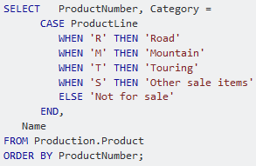
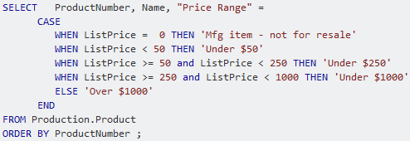
Case When Simple & Search

Slide 13
Case When Statement
CASE WHEN
Multiple Case Statements
Multiple When statements
Required to generate multiple rows using multiple logics
Example
SELECT dept_nbr,
(CASE
WHEN dept_nbr IN (1,2,3,4,5) THEN 'SBU1‘ WHEN dept_nbr IN (6,7,8,9,10) THEN 'SBU2' END) AS SBU FROM <tablename>
Used to implement multiple logics to
Example
SELECT dept_nbr ,
(CASE WHEN dept_nbr =1 THEN 'SBU1‘
ELSE ‘Others' END) AS SBU, (CASE WHEN store_nbr =1 THEN ‘STORE1‘
ELSE ‘Others' END) AS Store FROM <tablename>
Aggregation using Case when
Sum has to be given outside of case when, else it won't be an aggregated function. If SUM is not given outside of case, SQL does not recognize it as an aggregated function.
SELECT dept_nbr, Count (CASE WHEN dept_nbr IN (1,2,3,4,5) THEN Store_no END) AS Store_cnt FROM <tablename>

Slide 14
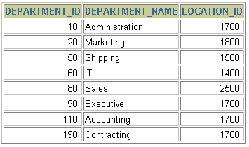




SQL Joins: Obtaining Data from Multiple Tables
DEPARTMENTS
EMPLOYEES
…
…
Notes:
Data from Multiple Tables
Sometimes you need to use data from more than one table. In the slide example, the report displays data from two separate tables.
Employee IDs exist in the EMPLOYEES table.
Department IDs exist in both the EMPLOYEES and DEPARTMENTS tables.
Location IDs exist in the DEPARTMENTS table.
To produce the report, you need to link the EMPLOYEES and DEPARTMENTS tables and access data from both of them.

Slide 15
Types of Joins
There are different types of joins available in SQL:
INNER JOIN: returns rows when there is a match in both tables.
LEFT JOIN: returns all rows from the left table, even if there are no matches in the right table.
RIGHT JOIN: returns all rows from the right table, even if there are no matches in the left table.
FULL JOIN: returns rows when there is a match in one of the tables.
SELF JOIN: is used to join a table to itself as if the table were two tables, temporarily renaming at least one table in the SQL statement.
CARTESIAN JOIN: returns the Cartesian product of the sets of records from the two or more joined tab
Inner Join
Left Join
Full Join
Table A
Table B
Table A
Table B
Table A
Table B
Notes:
Types of Joins
The Oracle9i database offers join syntax that is SQL: 1999 compliant. Prior to the 9i release, the join syntax was different from the ANSI standards. The new SQL: 1999 compliant join syntax does not offer any performance benefits over the Oracle proprietary join syntax that existed in prior releases.
Instructor Note
Do not get into details of all the types of joins now. Explain each join one by one, as is done in the following slides.

Slide 16
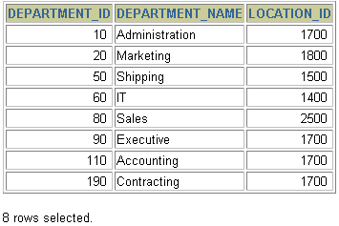
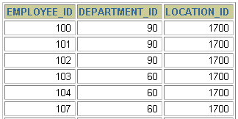
Generating a Cartesian Product
A Cartesian product is formed when:
A join condition is omitted
A join condition is invalid
All rows in the first table are joined to all rows in the second table
To avoid a Cartesian product, always include a valid join condition in a WHERE clause.
EMPLOYEES (20 rows)
DEPARTMENTS (8 rows)
…
Cartesian product: 20x8=160 rows
…
Notes:
Cartesian Products (continued)
A Cartesian product is generated if a join condition is omitted. The example on the slide displays employee last name and department name from the EMPLOYEES and DEPARTMENTS tables. Because no WHERE clause has been specified, all rows (20 rows) from the EMPLOYEES table are joined with all rows (8 rows) in the DEPARTMENTS table, thereby generating 160 rows in the output.
SELECT last_name, department_name dept_name
FROM employees, departments;
Instructor Note
Demo: 4_cart.sql
Purpose: To illustrate executing a Cartesian product
…

Slide 17
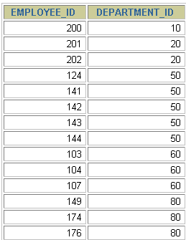
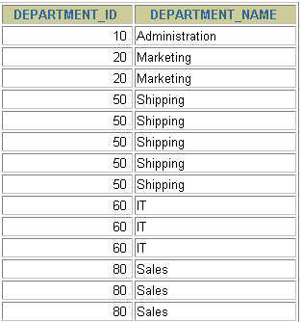
What is an Equijoin?
EMPLOYEES
DEPARTMENTS
…
…
Foreign key
Primary key
Notes:
Equijoins
To determine an employee’s department name, you compare the value in the DEPARTMENT_ID column in the EMPLOYEES table with the DEPARTMENT_ID values in the DEPARTMENTS table. The relationship between the EMPLOYEES and DEPARTMENTS tables is an equijoin—that is, values in the DEPARTMENT_ID column on both tables must be equal. Frequently, this type of join involves primary and foreign key complements.
Note: Equijoins are also called simple joins or inner joins.
Instructor Note
Explain the use of a decision matrix for simplifying writing joins. For example, if you want to display the name and department number of all the employees who are in the same department as Goyal, you can start by making the following decision tree:
Columns to Display Originating Table Condition
last_name employees last_name='Goyal'
department_name departments employees.department_id =
departments.department_id
Now the SQL statement can be easily formulated by looking at the decision matrix. The first column gives the column list in the SELECT statement, the second column gives the tables for the FROM clause, and the third column gives the condition for the WHERE clause.

Slide 18
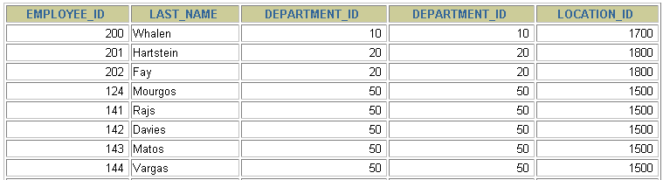
Retrieving Records with Equijoins
An equijoin is a join with a join condition containing an equality operator.
An equijoin returns only the rows that have equivalent values for the specified column
SELECT employees.employee_id, employees.last_name,
employees.department_id, departments.department_id,
departments.location_id
FROM employees, departments
WHERE employees.department_id = departments.department_id;
…
Notes:
Retrieving Records with Equijoins
In the slide example:
The SELECT clause specifies the column names to retrieve:
employee last name, employee number, and department number, which are columns in the EMPLOYEES table
department number, department name, and location ID, which are columns in the DEPARTMENTS table
The FROM clause specifies the two tables that the database must access:
EMPLOYEES table
DEPARTMENTS table
The WHERE clause specifies how the tables are to be joined:
EMPLOYEES.DEPARTMENT_ID = DEPARTMENTS.DEPARTMENT_ID
Because the DEPARTMENT_ID column is common to both tables, it must be prefixed by the table name to avoid ambiguity.

Slide 19
Using Table Aliases
Simplify queries by using table aliases.
Improve performance by using table prefixes.
Distinguish columns that have identical names but reside in different tables by using column aliases.
Aliases can be useful when:
There are more than one table involved in a query
Functions are used in the query
Column names are big or not very readable
Same column name exist in different tables
Two or more columns are combined together
SELECT e.employee_id, e.last_name, e.department_id,
d.department_id, d.location_id
FROM employees e , departments d
WHERE e.department_id = d.department_id;
Notes:
Table Aliases
Qualifying column names with table names can be very time consuming, particularly if table names are lengthy. You can use table aliases instead of table names. Just as a column alias gives a column another name, a table alias gives a table another name. Table aliases help to keep SQL code smaller, therefore using less memory.
Notice how table aliases are identified in the FROM clause in the example. The table name is specified in full, followed by a space and then the table alias. The EMPLOYEES table has been given an alias of e, and the DEPARTMENTS table has an alias of d.
Guidelines
Table aliases can be up to 30 characters in length, but shorter is better.
If a table alias is used for a particular table name in the FROM clause, then that table alias must be substituted for the table name throughout the SELECT statement.
Table aliases should be meaningful.
The table alias is valid only for the current SELECT statement.

Slide 20
Inner Join Syntax
Match rows between the two tables specified in the INNER JOIN statement based on one or more columns having matching data.
Although most join logic is based on matching values between the two columns specified, it is possible to also include logic using greater than, less than, not equals, etc.
Preferably the join is based on referential integrity enforcing the relationship between the tables to ensure data integrity.
Just to add a little commentary to the basic definitions above, in general the INNER JOIN option is considered to be the most common join needed in applications and/or queries. Although that is the case in some environments, it is really dependent on the database design, referential integrity and data needed for the application.
INNER JOIN will retrieve a results row only where there is a perfect match between the two tables in the join condition.
It can also often see one row from one of the tables matching multiple rows in the other table.
The following query is an example:
SELECT table1.column, table2.column
FROM table1 inner join table2
ON table1.column = table2.column;
Notes:
Using Outer Joins to Return Records with No Direct Match
The missing rows can be returned if an outer join operator is used in the join condition. The operator is a plus sign enclosed in parentheses (+), and it is placed on the “side” of the join that is deficient in information. This operator has the effect of creating one or more null rows, to which one or more rows from the nondeficient table can be joined.
In the syntax:
table1.column = is the condition that joins (or relates) the tables together.
table2.column (+) is the outer join symbol, which can be placed on either side of the WHERE clause condition, but not on both sides. (Place the outer join symbol following the name of the column in the table without the matching rows.)
Instructor Note
Demo: 4_ejoin.sql
Purpose: To illustrate an equijoin leading to an outer join.

Slide 21
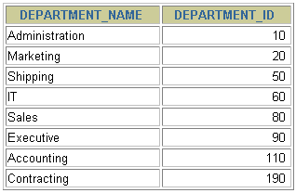
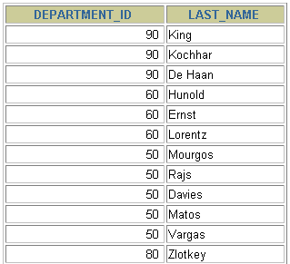
Outer Joins - Data
DEPARTMENTS
EMPLOYEES
…
There are no employees in department 190.
Notes:
Returning Records with No Direct Match with Outer Joins
If a row does not satisfy a join condition, the row will not appear in the query result. For example, in the equijoin condition of EMPLOYEES and DEPARTMENTS tables, employee Grant does not appear because there is no department ID recorded for her in the EMPLOYEES table. Instead of seeing 20 employees in the result set, you see 19 records.
SELECT e.last_name, e.department_id, d.department_name
FROM employees e, departments d
WHERE e.department_id = d.department_id;
…

Slide 22

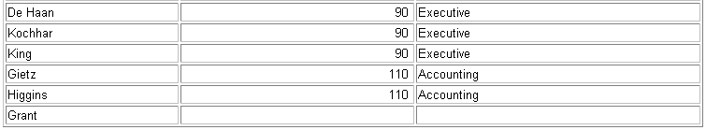
LEFT OUTER JOIN
LEFT OUTER JOIN - Based on the two tables specified in the join clause, all data is returned from the left table. On the right table, the matching data is returned in addition to NULL values where a record exists in the left table, but not in the right table.
Another item to keep in mind is that the LEFT and RIGHT OUTER JOIN logic is opposite of one another. So you can change either the order of the tables in the specific join statement or change the JOIN from left to right or vice versa and get the same results.
SELECT e.last_name, e.department_id, d.department_name
FROM employees e
LEFT OUTER JOIN departments d
ON (e.department_id = d.department_id) ;
…
Notes:
Example of LEFT OUTER JOIN
This query retrieves all rows in the EMPLOYEES table, which is the left table even if there is no match in the DEPARTMENTS table.
This query was completed in earlier releases as follows:
SELECT e.last_name, e.department_id, d.department_name
FROM employees e, departments d
WHERE d.department_id (+) = e.department_id;

Slide 23
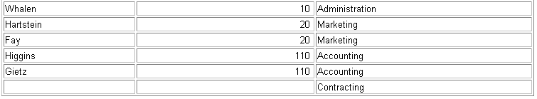
RIGHT OUTER JOIN
RIGHT OUTER JOIN - Based on the two tables specified in the join clause, all data is returned from the right table.
On the left table, the matching data is returned in addition to NULL values where a record exists in the right table but not in the left table.
SELECT e.last_name, e.department_id, d.department_name
FROM employees e
RIGHT OUTER JOIN departments d
ON (e.department_id = d.department_id) ;
…
Notes:
Example of RIGHT OUTER JOIN
This query retrieves all rows in the DEPARTMENTS table, which is the right table even if there is no match in the EMPLOYEES table.
This query was completed in earlier releases as follows:
SELECT e.last_name, e.department_id, d.department_name
FROM employees e, departments d
WHERE d.department_id = e.department_id (+);

Slide 24
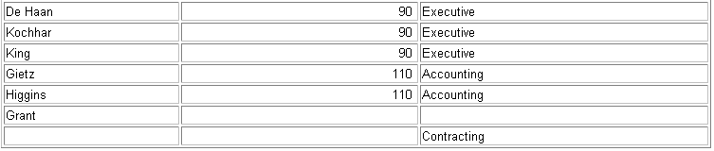
FULL OUTER JOIN
FULL JOIN - Based on the two tables specified in the join clause, all data is returned from both tables regardless of matching data
SELECT e.last_name, e.department_id, d.department_name
FROM employees e
FULL OUTER JOIN departments d
ON (e.department_id = d.department_id) ;
…
Notes:
Example of FULL OUTER JOIN
This query retrieves all rows in the EMPLOYEES table, even if there is no match in the DEPARTMENTS table. It also retrieves all rows in the DEPARTMENTS table, even if there is no match in the EMPLOYEES table.
Instructor Note
It was not possible to complete this in earlier releases using outer joins. However, you could accomplish the same results using the UNION operator.
SELECT e.last_name, e.department_id, d.department_name
FROM employees e, departments d
WHERE e.department_id (+) = d.department_id
UNION
SELECT e.last_name, e.department_id, d.department_name
FROM employees e, departments d
WHERE e.department_id = d.department_id (+);

Slide 25
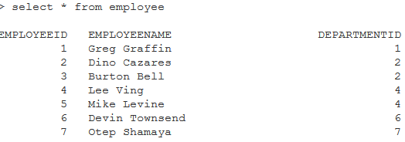
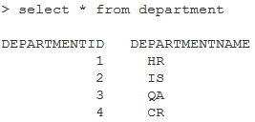
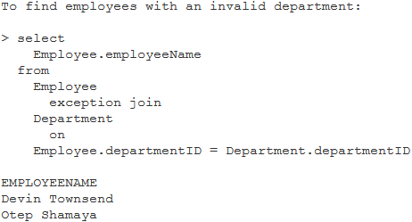
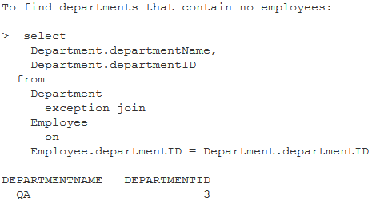
Exception JOIN
Notes:
Example of FULL OUTER JOIN
This query retrieves all rows in the EMPLOYEES table, even if there is no match in the DEPARTMENTS table. It also retrieves all rows in the DEPARTMENTS table, even if there is no match in the EMPLOYEES table.
Instructor Note
It was not possible to complete this in earlier releases using outer joins. However, you could accomplish the same results using the UNION operator.
SELECT e.last_name, e.department_id, d.department_name
FROM employees e, departments d
WHERE e.department_id (+) = d.department_id
UNION
SELECT e.last_name, e.department_id, d.department_name
FROM employees e, departments d
WHERE e.department_id = d.department_id (+);

Slide 26
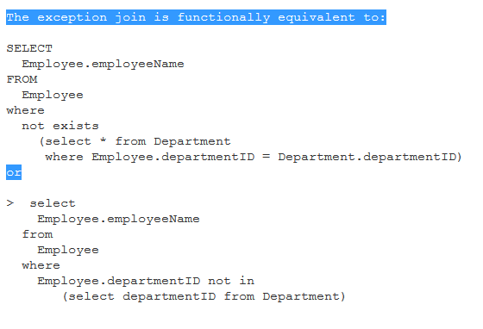
Exist & In
Note: Please refer Exception Join slide (24)

Slide 27
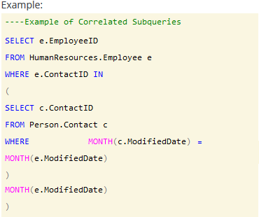
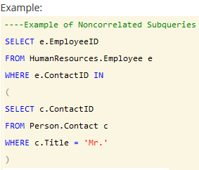
Sub query
Correlated Subquery (synchronized subquery)
A query is called correlated subquery when both the inner query and the outer query are interdependent. For every row processed by the inner query, the outer query is processed as well. The inner query depends on the outer query before it can be processed.
Non-correlated Subquery
A class of queries is evaluated by running the subquery once and then substituting the resulting value or values into the WHERE clause of the outer query. These self-contained queries are called noncorrelated subqueries; you can run them by themselves and inspect the results independent of their containing statements

Slide 28
Union and Union all
The UNION operator is used to combine the result-set of two or more SELECT statements.
Notice that each SELECT statement within the UNION must have the same number of columns. The columns must also have similar data types. Also, the columns in each SELECT statement must be in the same order.
SELECT column_name(s) FROM table1 UNION SELECT column_name(s) FROM table2;
Rules to union data:
Each query must have the same number of columns
Each column must have compatible data types
Column names for the final result set are taken from the first query
ORDER BY and COMPUTE clauses can only be issued for the overall result set and not within each individual result set
GROUP BY and HAVING clauses can only be issued for each individual result set and not for the overall result set
Union All-this command again allows you to join multiple datasets into one dataset, but it does not remove any duplicate rows. Because this does not remove duplicate rows this process is faster, but if you don't want duplicate records you will need to use the UNION operator instead.
The SQL EXCEPT operator is used to return all rows in the first SELECT statement that are not returned in the second SELECT statement. Each SELECT statement within the EXCEPT query must have the same number of fields in the result sets with similar data types.
SELECT expression1, expression2, ... expression_n FROM tables
Except
SELECT expression1, expression2, ... expression_n FROM tables;

